Slide 1
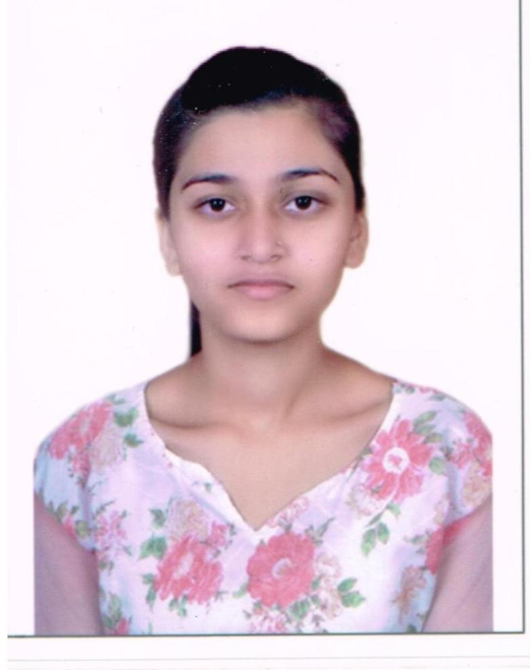
Khushbu Gupta
Analyst /Software Engineer
Master’s of Technology(M.Tech) in Computer Science Engineering with 81.6% in 2018-2021.
Bechlore of Engineering(B.E) in Computer Science with 77.79% in 2013-2017.
PUNE
KHUSHBU.GUPTA@CAPGEMINI.COM
8109170600
Skills
A4
Language | C,C++,C#,JAVA
Web Api | Developing web page by using web API.
Database | MySQL, SQL Server
Tools | GIT, PowerApps , Sharepoint
UI Technology | HTML5 and CSS
Soft Skills | Communication Skills, Quick Learner, Team Management
FULL STACK DEVELOPER TRAINED ON .NET CORE WITH AZURE
Understanding of RDBMS concepts using SQL Server.
Practical understanding of C# and SQL concepts using Visual Studio and SQL Server
Hands on experience in developing applications using .NET Framework ,Web API,MVC, SQL Server and Microsoft Azure.
Completed the course on I-Transform-Microsoft .NET Core and Azure Fundamentals.
Completed Training & working on PowerApps.
Certification
Microsoft Az-900 Certified.
Agile Software Development.
Completed case study on Online Vehicle Rental Management System which provision for customers to book vehicle and get it delivered or collect the vehicle from the company.
Design Leave Management System which helps in recording, managing, and tracking employees time-off requests. Its main objective is to handle employees’ leave requests impartially while ensuring that the employees’ absence from work doesn’t adversely impact the business.
Design Face Detection based Attendence System which is developed for an easy and a secure way of taking down Attendance.

